Slide 1
AUTOMATIC CLASSIFICATION OF POEMS BY THEMES
Aaditya Suri: 300252128
Paritosh Pal Singh: 300218161
Ranjan Goyal: 300219315

Slide 2
Abstract
Poetry is a special form of literature and is important for computational linguistics. It is believed to be the most free literary genre; other genres depend on plot, narrative, characters, but poetry is free from such restrictions. Poetry has existed as a captivating form of literature for centuries and conveys ideas, meaning, emotions and stories by using words for their meanings and acoustics. It can contain emotions, figures of speech, and creativity. Poetry compared to all other application of Natural Language processing possesses much greater challenge than other literary genres. Analytics and computational linguistics with poetry can play a quintessential role as it can help facilitate drawing inferences for voice statistics, uncertainty, inquisitiveness, and feelings in speech or text. Understanding the poetry through text and deducing the message to extract the information about the theme can be an extremely tedious task. Additionally, the classification of poems is also a challenging task as there are fewer discriminative word features since poetry is generally written in short paragraphs. Moreover, as the entire context of poetry cannot be taken in literal sense as it almost always has a deeper contextual connection and meaning.

Slide 3
Problem Statement
In this project, a classification based on the theme of poems is proposed.
In this project, we attempt to resolve both the problem statements by using state of the art NLP pipeline for understanding the text and classifying poems to appropriate categories.

Slide 4
Dataset and About the Data
For this project, we will be using the Poems Dataset from Kaggle which consists of 135 directories and each directory has poems of that category such as alexandrine, allegory, haiku, etc.
The dataset is a collection of poems and are characterized by the form like haiku, sonnet, etc. and some are on the topics of love, nature, joy, peace, etc.

Slide 5
Data Preparation and Transformation
We are selecting the data to be used and pre-processing by cleaning the text and making it usable for the process of generating feature vectors using word embedding models.
In preprocessing we have removed punctuations, stop words, redundant words and any other jargon which doesn’t relay information required to generate vectors. Subsequently, the Whitespace Tokenizer and Lemmatization using wordnet from nltk was used.

Slide 6
Data Preparation and Transformation
Remove Punctuations: It helps to get rid of unwanted parts of the data including noise, by converting all the characters to lowercase and removing punctuation marks, and removing stop words and any typos. The code
Tokenization: Tokenization splits the whole sentences into words. We have used the Whitespace Tokenizer and tokenized the various poems.
Remove Stopwords: Removing words like ‘a’, ‘our’, ‘for’ helps the model to consider only key features, as these common words don’t carry much information and by eliminating them, the models can focus and achieve better results as they work only on the important words.
Lemmatization: Lemmatization performs normalization using vocabulary and morphological analysis of a word, which is known as the lemma. We have used the WordNetLemmatizer from the nltk library and rather than simply lemmatizing the tokens only, we have passed the words before and after a certain word which imporves the entire process of lemmatization.

Slide 7
Data Preparation and Transformation
The preprocessed data is then transformed using CountVectorizer and TF-IDF Transformer. This transformed data is then fed into Machine Learning Models like Random Forest and CatBoost.
Count Vectorizer: It is used to convert a collection of text documents to a vector of term/token counts. This also enables preprocessing of text data prior to generalizing the vector representation. Which ultimately makes it flexible feature representation module for text.
TF-IDF: Term Frequency – Inverse Domain Frequency and it is a measure used to quantify the importance of string representations like words, phrases, lemmas, etc. in a document amongst a collection of documents.

Slide 8
Machine Learning Models
Decision Tree: Decision Trees are non-parametric supervised learning method used for classification and regression.
Random Forest: The random forest is a classification algorithm consisting of many decision trees. It is a bagging approach and feature randomness while building each unique tree to try and create an uncorrelated forest of trees whose prediction by voting is more accurate than that of any tree individually.
CatBoost: CatBoost is a boosting technique which works on the gradient boosting framework. It uses symmetric trees that aids in making fast inferences. And as it is a boosting technique, it reduces overfitting overtime and improves the quality of the model.

Slide 9
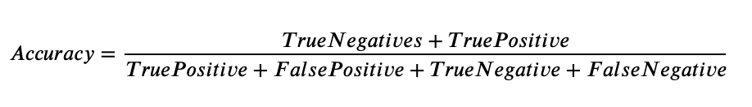
Performance Evaluation
In this project we will also be benchmarking the performance of various classification methods over the same text and also how their performance vary in conjunction with word embedding algorithms.
There are multiple performance metrics chosen to indicate and show which algorithms are better in deducing the correct theme for a poem.
Accuracy – Allows to measure the total number of predictions a model gets right.

Slide 10
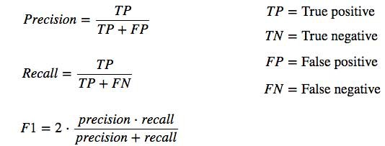
Performance Evaluation
2. Precision – This metric quantifies the number of correct positive predictions made. Precision calculates the accuracy for the minority class.
3. Recall – This metric that quantifies the number of correct positive predictions made out of all positive predictions that could have been made.
4. F1 Score – F1-score combines the precision and recall metrics into a single metric. F1-score is the harmonic mean of precision & recall

Slide 11
Performance Evaluation

Slide 12
Results

Slide 13
Conclusions

Slide 14
Future Scope
For future, we can focus our attention towards more precise prediction of themes of poems. The algorithm and pipeline should be able to drill down more and deduce even the subcategories and tags for the poems.
We also aim to visit some existing research techniques and literature to improve our pipeline in way where we can use custom features, better algorithms, custom trained models and techniques to generate better and more insightful results.

